Slide 1
Cancer Stem Cells

Slide 2
Recently biologically distinct and relatively rare populations of tumor-initiating cells have been identified in cancers of the hematopoietic system, brain and breast. Cells of this type have the capability of:
  Self renewal
  Potential to develop into any cell in the overall tumor population
  The proliferative ability to drive continued expansion of the population of malignant cells.

Slide 3
Given these features, it is possible that cancer stem cells arise by mutation from normal stem cells or mutated progenitor cells.
These progenitors are also called transit amplifying cells which possess substantial replicative activity, but do not usually have the self renewal capacity of the stem cells. Those cells also to become cancer cells they must acquire mutations that cause them to gain the property of self renewal.

Slide 4
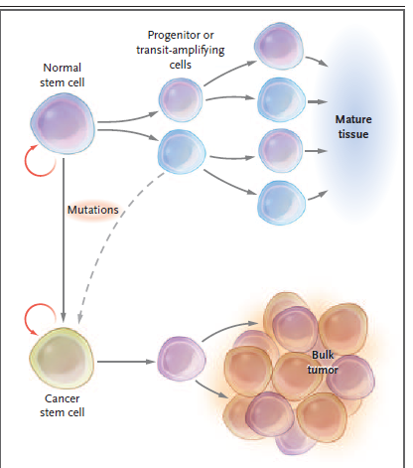
Stem-Cell Systems

Slide 5
Cancer stem cells can be the source of all the malignant cells in primary tumor, they can compose the small reservoir of drug-resistant cells that are responsible for the relapse after chemotherapy induced remission(recovery) or can give rise to distant metastasis.
It is becoming evident that a cancer treatment regimen that fails to eliminate cancer stem cells may allow re-growth of the tumor. Therapeutic strategies that specifically target cancer stem cells should eradicate tumors more effectively than current treatments and reduces the risk of relapse and metastasis.

Slide 6
Cancer Stem Cells in the Hematopoietic, Brain and Breast Systems
In various types of leukemia, cancer stem cells have been unambiguously identified and several biologic properties of these stem cells have been found to have direct implications for therapy.
Stem cells responsible for certain leukemia’s are mostly quiescent, suggesting that conventional anti-proliferative cytotoxic regimens are unlikely to be effective against them.

Slide 7
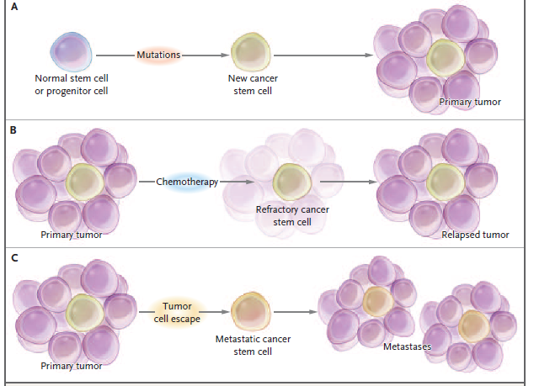

Slide 8
Some of those cells (hematopoietic system) have surface markers such as interleukin-3 receptor alpha chain that are not present on normal stem cells. Other unique molecular features of leukemia stem cells are; nuclear factor kB (NF-kB) and phosphatidylinositol 3’ kinase (PI3).
None of those is detected in resting normal hematopoietic stem cells. These markers may be useful for antibody-based or related therapeutic regimens as they could be tumor-specific targets.
Similarly, it has been recently proved that normal neural stem cells (Brain system) express a cell surface protein that can be detected with an antibody against CD 133 epitope.

Slide 9
This marker is commonly found on cancer stem cells. The transplantation of as few as 100 cells of this type (CD 133 positive) into the brain of an immunocompromised mouse resulted in brain tumor while the transfer of 10⁵ normal cancer cells that are CD-133 negative did not initiate the tumor.
This proves that although the later cells were taken from the tumor directly (i.e they are cancerous cells) they fail to develop cancer as only subpopulation which are the CD133 positive are responsible for the cancer.

Slide 10
Similar to the brain, studies of specimens from patients with advanced stages of metastatic breast cancer demonstrated the presence of cells with specific cell surface antigen profile (CD 44- positive and CD 24 negative) could successfully establish themselves as tumor xenografts (human tumor cells are transplanted under the skin or into the organ type in which the tumor originated, into immunocompromised mice that do not reject human cells).

Slide 11
Challenges for therapy targeted against cancer stem cells
The development of treatments that target cancer stem cells is an important objective.
To design a treatment that selectively eradicates cancer stem cells, it is useful to have cognate (related) normal stem cells.
This requires the development of assays to characterize the function of normal stem cells and the means to define their physical features i.e cell surface markers that will permit their isolation.

Slide 12
It is critical to understand how cancer stem cells differ from normal stem cells particularly with regard to mechanisms controlling cells survival and response to injury.
It is necessary to understand how therapies that effectively target the bulk of the tumor cells fail to eradicate cancer stem cells.

Slide 13
Understand the properties of cancer stem cells that make them difficult to kill by treatment regimens.
How does some cancer cells survive the therapy and re-grow after the treatment?
It appears that a variety of cancer cells particularly during relapse express multidrug-resistant proteins thus providing resistance to many chemotherapeutic agents.

Slide 14
Conclusion
The eradication of bulk disease is not likely to predict the efficacy of drug regimens for rare cancer cells as it is pivotal to eradicate the cancer stem cells to insure the efficacy of such drug.
Therefore, the development of assays that measure the survival of cancer stem cells will be important for assessing the potential of new targeted regimens.
Craig T. Jordan, Monica Guzman, and Mark Noble. (2006). Cancer Stem Cells. The New England Journal of Medicine. 355 (12): 1253-1261.

